Slide 1
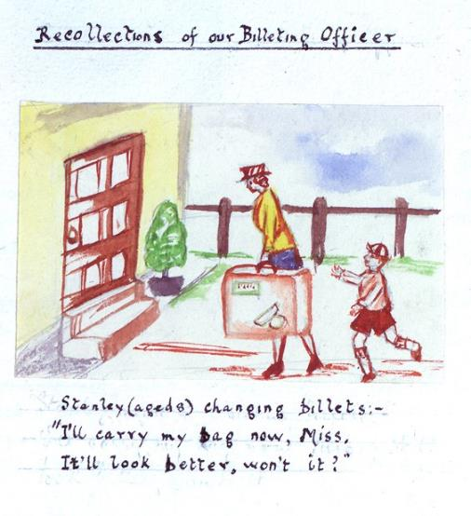
1st September 1939 –
2nd September 1945
Dorset
Notes:
DHC - W-19-1-p130- Verwood ‘Recollections of our Billeting Officer’
This image comes from a big book which tells us about all the ways that the Women’s Institute in dorset helped with the war effort. The image comes from the pages dedicated to the Verwood branch and has been painted by a member of the WI. It is headed ‘Recollections of a Billeting Officer’. Can you think of another word for recollection? Do you remember what billets are?
Stanley (Age 8) changing billets – ‘I’ll carry my bag now Miss, It’ll look better, won’t it?’ - what is happening to Stanley? Where are he and the billeting officer? Why did Stanley say it would look better if he carried his bag? How do you think Stanley feels? If he had been moving to your house, how would you welcome him in?

Slide 2
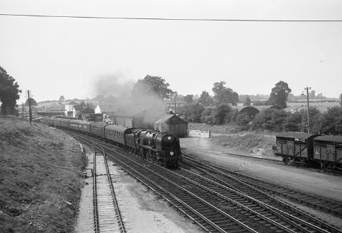
…‘we walked, in a long crocodile I remember, to Waterloo Station with luggage labels tied on our coats and we were put on the train and, er, our parents did not know where we were going.’
Edna Bolton
What was it like to be evacuated ?
Listen carefully to the clip of Edna talking about her time as an evacuee. Jot down a a few words about her experience.
“We left because of the doodlebugs;  my friend was killed, and our house was hit….
“Mum said, ‘We have lost our roof, so we are going.’
John Honeybone
Semley Railway Station
Notes:
This slide shows primary sources – both written first hand accounts and a sound recording. These are the types of thing we look after at DHC so that we have evidence about the past. This is how we know about the past.
Transcript: Edna Bolton – DSA5 clip1
RD Can you explain to me what that meant and when you were billeted?
EB Well it seemed that well before war was declared the government, ah, put into operation a programme to take the children out of London and other areas which they felt would be bombed and people living in what they considered would be safe areas were asked, um, to tell them how many rooms they had and how many people occupied the house and the government arranged this programme whereby children who wished to leave London, it wasn’t compulsory, ah, could be transported, you know, and put into a safe part of the country. If you had spare rooms, I think you were expected to take them, you didn’t say ‘no I don’t want any evacuees’, erm, which is what we were called and, er, when it was obvious that there was going to be a war we were moved out of London. I was only five and a half at the time. I wasn’t actually old enough to go but people who had older sisters who fell within the right age, um, in the span to be evacuated, could apply to take a younger member of the family with them. Although I had no one else there were two girls who lived in the flats where we lived and my mother applied for me to come with them to get me out of London and so on the Saturday, we were, er, this was from John Ruskin school in the east, eastern part of London, not quite sure of my address now, but, erm, we walked to, in a long crocodile I remember, to Waterloo Station with luggage labels tied on our coats and we were put on the train and, er, our parents did not know where we were going. It was all very secretive, um, but I do remember going through stations and seeing them lined with troops as we were coming south, they were going presumably towards London. When we eventually were, um, um, disembarked, whatever the word is, at Semly station which was in operation in those days, it’s since closed erm United Diaries had a depot opposite the station…….
Doodlebugs The V-1 flying bomb.
https://www.lookandlearn.com/history-images/A010014/V1-Rocket-Doodlebug

Slide 3
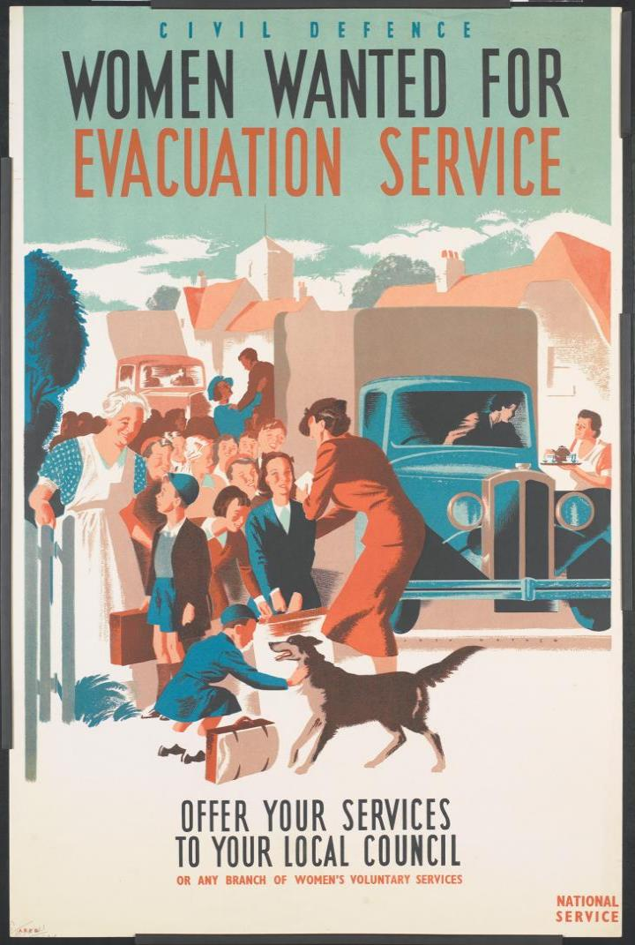
Billeting
Government Poster requesting Volunteers to help children find homes
What is it ?
Definition:
the activity of assigning soldiers or others to accommodation that is not normally used by them.
Collins Dictionary
Billeting officers were responsible for helping to find homes for the evacuees.
Householders in the country who billeted city children were given money by the government.
They were called ‘Host Families’
Notes:
Poster - https://www.iwm.org.uk/
 Billeted - a place is provided for them to stay in for a period of time. (v)
Look carefully at the poster, which was made by the Government during the War. What has the artist done to catch your eye and to make the poster appealing to look at? (bright colour in centre, friendly dog, an old fashioned figure of a woman in a mobcap, good use of only 3 colours at different densities)
Who is being asked for help?
What can you see women doing in the illustration – look closely.
Why was billeting, accommodating and caring for children being expected from women?
Do you think your Mum or carer would welcome an evacuee?

Slide 4
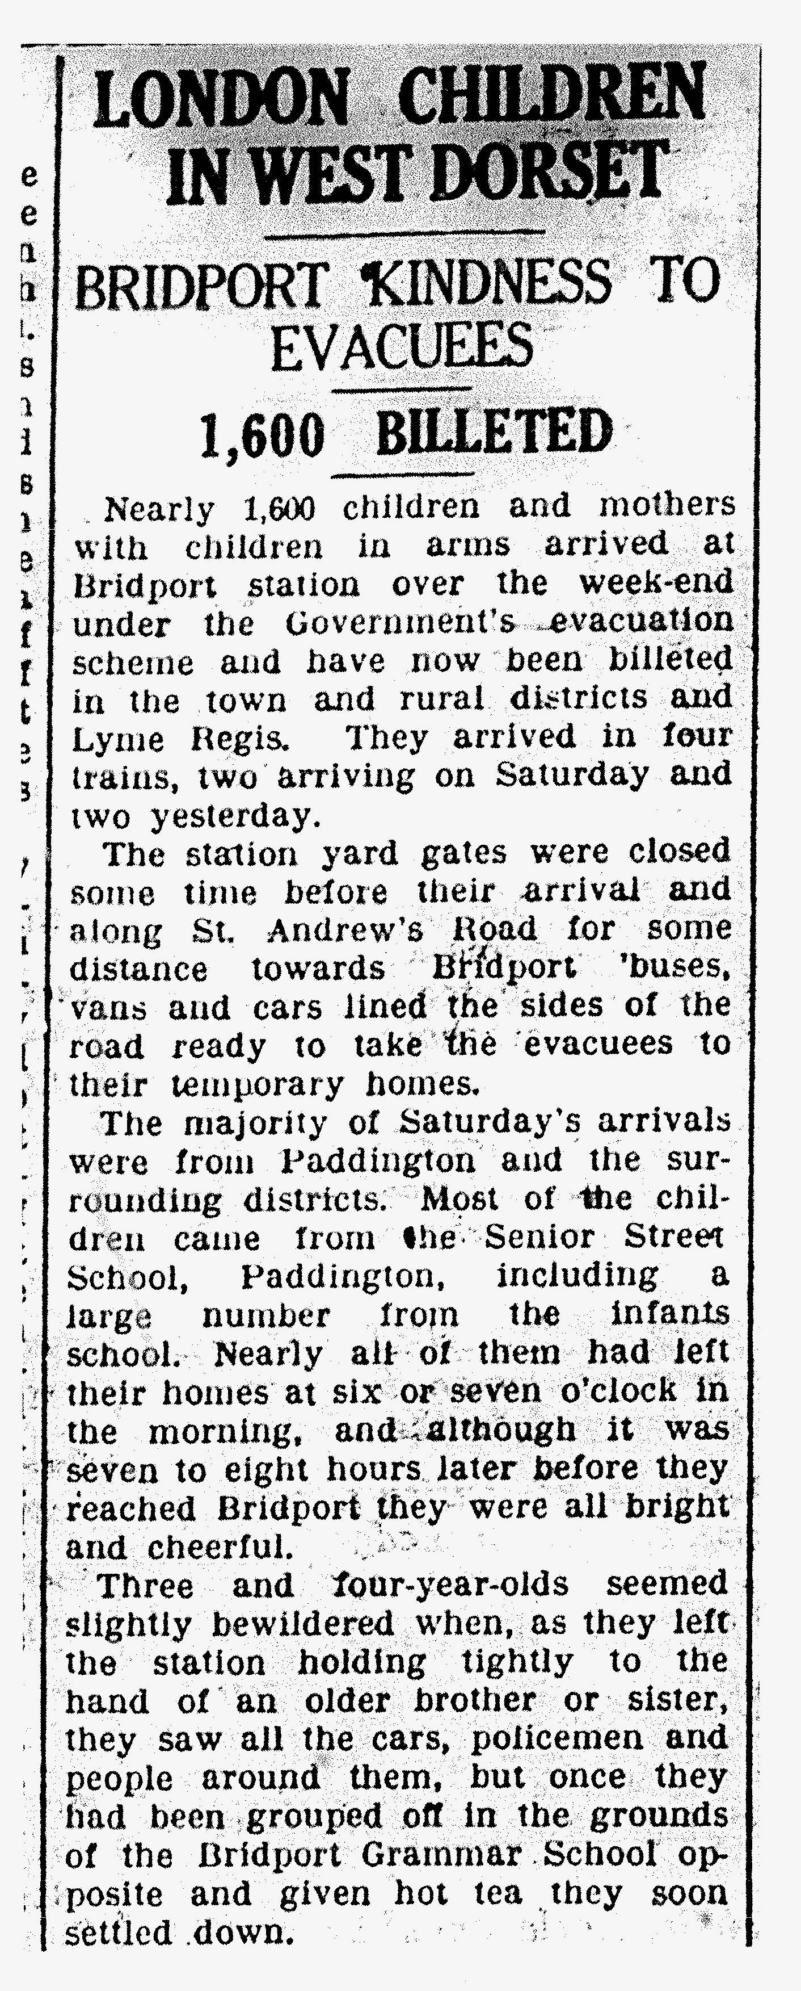
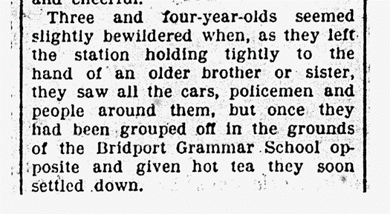
On Arrival
They were taken to a town or village hall, where they would be met by the billeting officer 
Host families would choose children they thought most suitable to live with them.
Often the more unhealthy or unclean children were left until last.
Children arrived in the
countryside, hungry, tired, and not knowing if they would ever see their families again.
Some saw it as an adventure.
Notes:
Shared reading from the screen
Local Newspaper exercise –DHC - Dorset Daily Echo 04 09 37
Q’s to be answered on whiteboards between 2
How many children and mothers arrived in Bridport as evacuees over this Sept weekend in 1939?
Where had they come from ?
How many trains carried them down to Dorset?
How long had it taken them to get to Dorset from their homes?
Where were the children being billeted? (Bridport, Lyme Regis)
How did the 3 and 4 year old children feel when they arrived? (bewildered) What is another way of saying this ?
What were they given to help them settle down ?
Talk about your thoughts on how children were chosen by Hosts.
 Billeting officer- the person in charge of finding them homes.

Slide 5
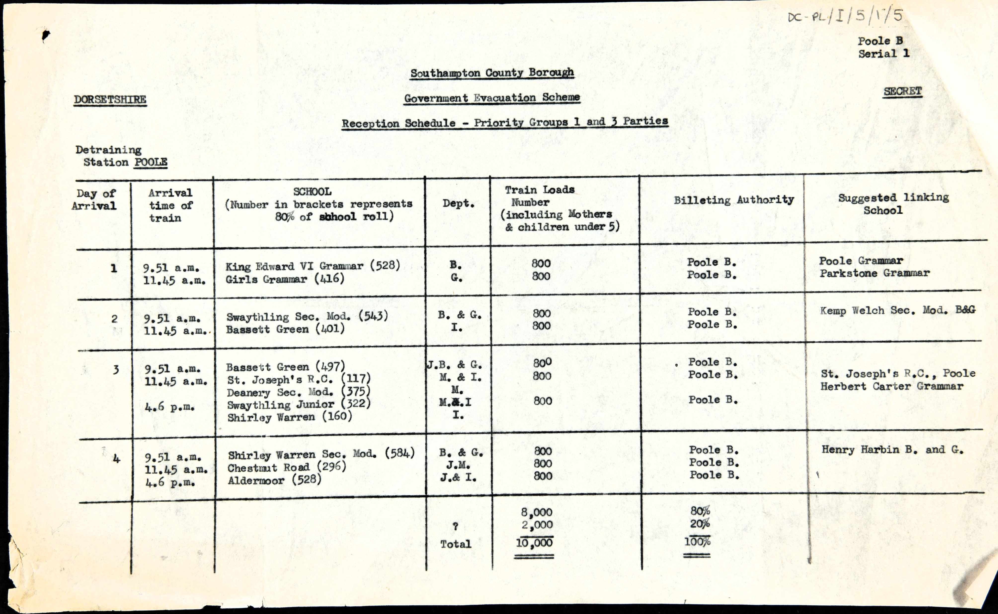
What is different now about the name of the County?
Why do you think this document was secret ?
Suggested new school
On Arrival
Number of evacuees on each train arrival
Example:
Southampton ‘Reception Schedule’  Official document showing school organisation for evacuees by local councils
How many trains were there to Southampton each day?
How many evacuees were there in total in the 4 days?
Notes:
Use the questions to help understand the numbers of evacuees coming into this area.
Schedule - A schedule is a plan that gives a list of events or tasks and the times at which each one should happen or be done.
 Allocation - to assign for a particular purpose (V)

Slide 6
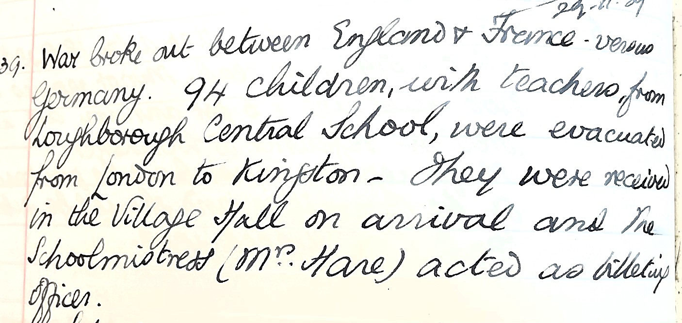
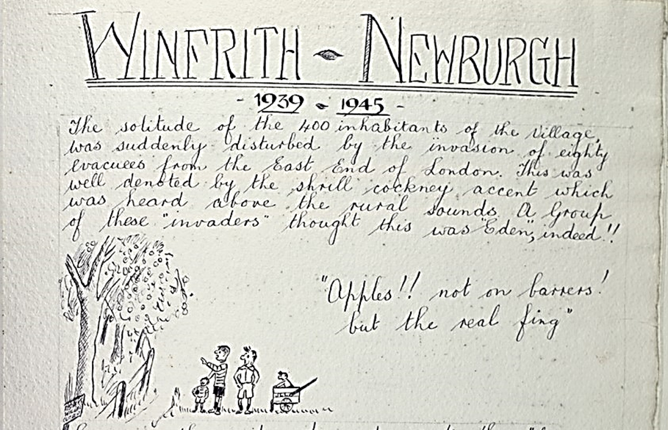
Hosts
People who received evacuees got six shillings a week from the Government. Some found this a good source of income applying for lots of children, some four or five.
Mrs Edna Bolton
Many children from the inner cities had never seen the countryside or farm animals.
Notes:
Three primary sources –a quote from an oral history recording, one entry from a school logbook and a page from the Women’s Institute War Record Book. Who made those records? A woman remembering being an evacuee, a teacher and a member of the Women’s Institute. Why did they make them – a record of school life, a record of the WI’s wartime activities and to share personal memories with people of the future.
What records do you and / or your school make – e.g. registers or awards books or the school website. Many new records are digital.
Transcript: DHC- W- 19-1 p.138 Winfred-Newburgh Womens’ Institute.
1. ‘The solitude of the 400 inhabitants of the village was suddenly disturbed by the invasion of eighty evacuees from the East End of London. This was denoted by the shrill cockney accent which was heard above the rural sounds. A Group of these ‘invaders’ thought this was ‘Eden’ indeed.!!’
‘Apples !! not on barrers! But the real fing’ – phonetic spelling of the working class / urban accents of the children – say it out loud as it is written – but what does it mean?
1. Why had some city children never seen the countryside? (no tv, few cars). But they would have seen illustrations in children’s books.
2. What is ‘Eden’ ?
Why would the children compare the rural environment to Eden?
What is a ‘barrer’ (barrow). Where might this be seen by the children? (at markets)
3. DHC - PE-KIP/SC/1/1 Transcription (Kingston School) War broke out between England & France v Germany. 94 children with teachers from Loughborough Central School (Leicestershire) were evacuated from London to Kingston –They were received in the Village Hall on arrival and the Schoolmistress (Mrs Hare) acted as billeting officer.
Kingston is a small village situated about 2 miles south of Corfe Castle.
Kingston School 1940 https://kingstonopc.org.uk/buildings-places/school/

Slide 7
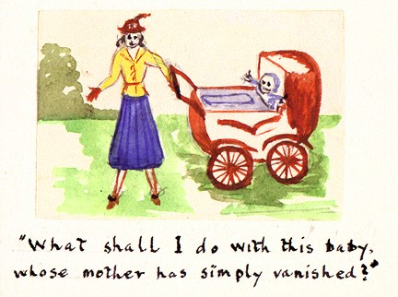
Billeting
Not everyone wanted to take evacuees.
Billeting however was compulsory.
People who refused to take evacuees into their homes without a good reason could be taken to court and fined
What shall I do with this baby whose mother has simply vanished !
Notes:
This is a difficult situation for the billeting officer.
How do think she solved the situation ?
Could you create a story about what might happened ?
HOTSEATING
 Compulsory - required by regulations or laws; obligatory

Slide 8
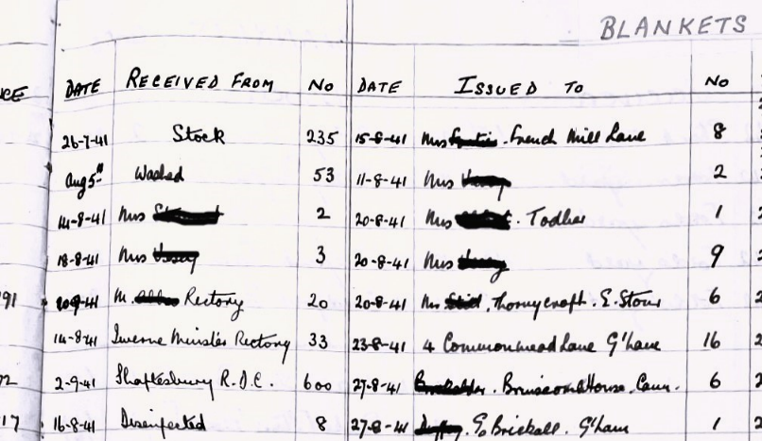
Hosts – equipment
Local councils were called upon to provide enough extra equipment and furniture so that hosts could make evacuees comfortable.
.
Family homes were not the only type of billet,
hotels and hostels were also used
This is section of a page taken from a Shaftesbury Inventory  account showing the number of blankets received and the homes they were distributed to.
What details do you see in the information ?
Notes:
D- 552/6 – Shaftesbury Inventory Account
RDC = Regional Distribution Centre
There are 2 columns – both with dates – ‘received from’ and issued to’ – what does ‘issued’ mean?
What was the smallest number of blankets donated?
Who provided the biggest number of blankets?
Who received the greatest number of blankets. 4, Commonmead Lane – a guest house (small hotel). Would you rather have been evacuated to a guest house or a private, family home? Why?

Slide 9
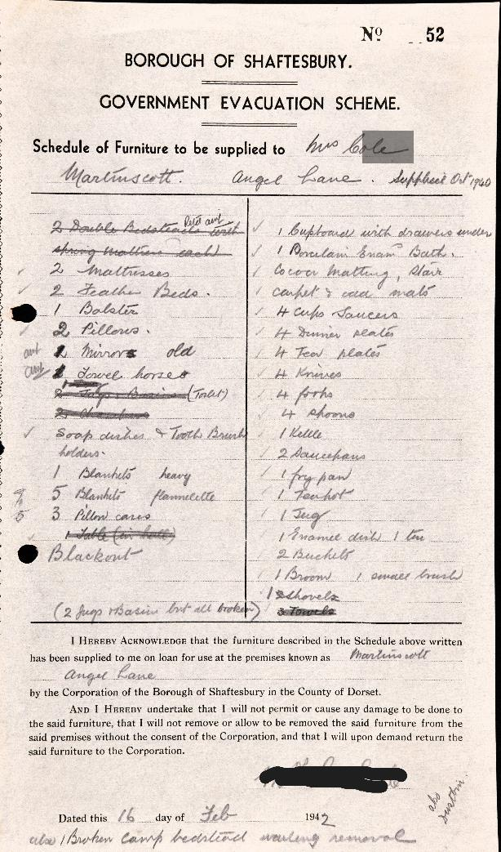
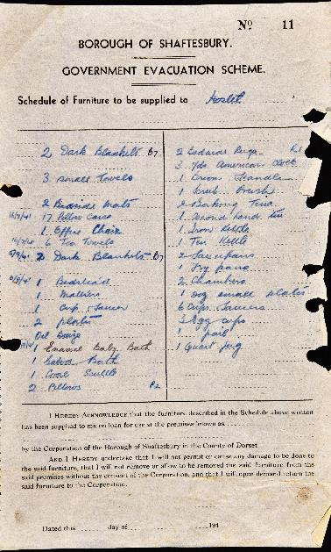
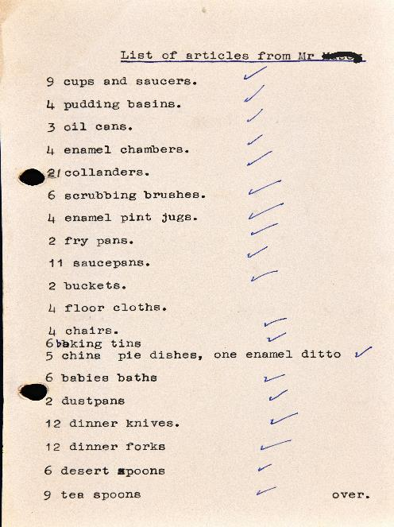
Here are examples of ‘Schedules of Furniture’ supplied to Hosts to help them provide for the evacuees
This Photo by Unknown Author is licensed under CC BY-NC
Notes:
Note that one is not on an official form. Which one? How can you tell the difference? How do you think the other list was made?
Use the copies and transcripts of the forms to complete the ‘Schedule of Furniture’ Activity sheet.

Slide 10
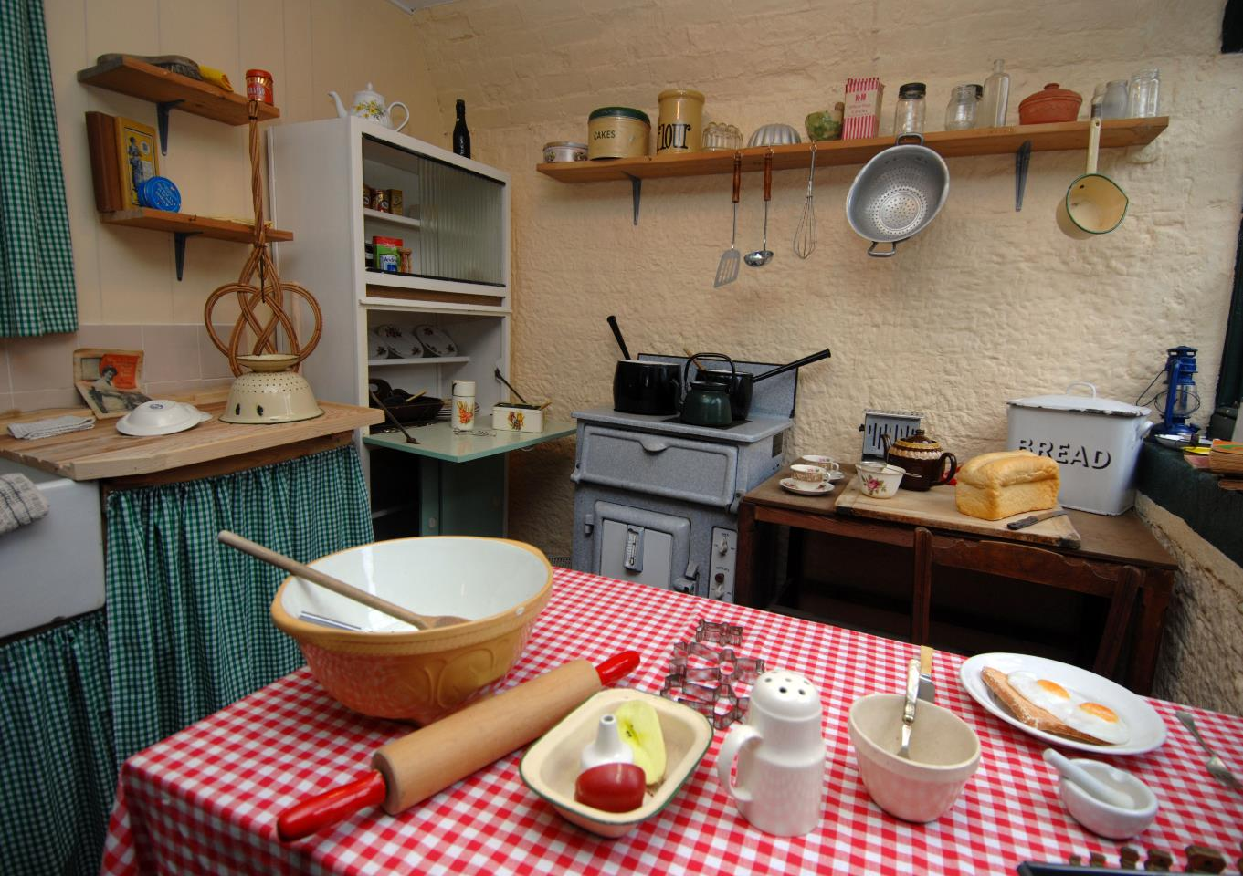
Example of an average 1940’s kitchen area
Some of the items will be found on the Equipment lists you will see next.
Use your observational skills - can you see anything which you don’t have in the kitchen at home?
Notes:
Summary point – people in the 1940’s lived in smaller homes and had less things, so they needed extra furniture an equipment to help accommodate the refugees.
‘Schedule of Furniture Activity Sheet’
Useful youtube links:
https://youtu.be/bhdxmKcmVzw The living Room
https://youtu.be/HPVvta-tHC8 The Kitchen
https://www.iwm.org.uk/learning/resources/the-1940s-house

